Slide 1
Four Crescents
What’s the area of the four yellow crescents?
Notes:
Area equals that of the rectangle. Confuse by giving rectangle dimensions as reciprocal surds. Solve with algebra.

Slide 2
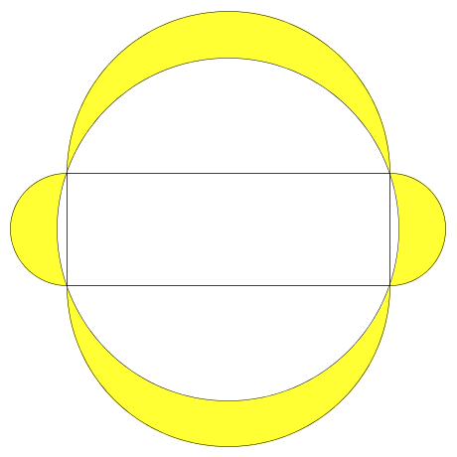


Four Crescents
The diagram shows a circle, four semi-circular arcs and a rectangle (with dimensions given).
What is the total area of the four shaded crescents?
$$\frac{\left(1+\sqrt{5}\right)}{2}$$
$$\frac{\left(−1+\sqrt{5}\right)}{2}$$
Notes:
Area is 1 ( = length x breadth )

Slide 3
Four Crescents
Compare your answers with others
  What do you notice?
  Can you justify any inferences you make?
Try the problem with different rectangle dimensions, e.g. 5cm x 4cm, 16cm x 7cm, anything you like
  What do you notice now?
Can you prove your assertions?

Slide 4
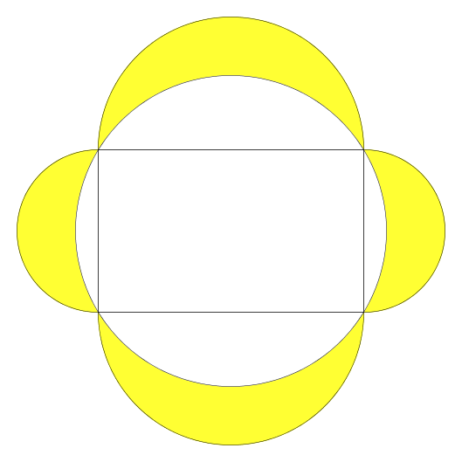


Let’s look at the general case.
$$a$$
$$b$$
Notes:
Area is 20 ( = 5 x 4 )

Slide 5
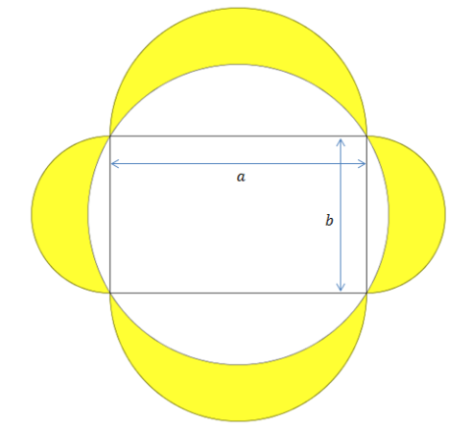
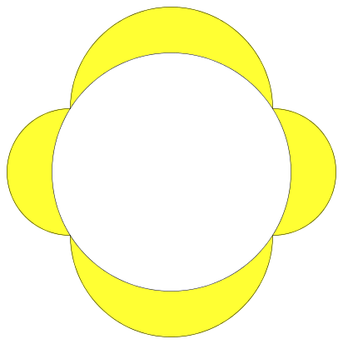
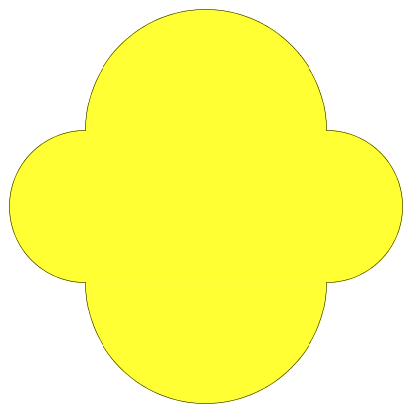

=
-

Slide 6
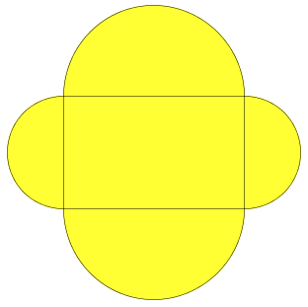
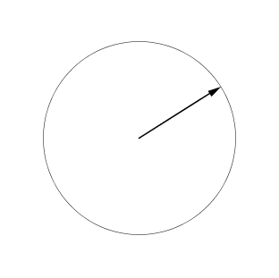


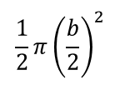
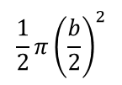




$$\frac{1}{2}π{\left(\frac{b}{2}\right)}^{2}$$
$$\frac{1}{2}π{\left(\frac{a}{2}\right)}^{2}$$
=
=
$$ab$$
$$ab+\frac{π}{4}\left(a^{2}+b^{2}\right)$$
$$\frac{1}{2}π{\left(\frac{a}{2}\right)}^{2}$$
$$\frac{1}{2}π{\left(\frac{b}{2}\right)}^{2}$$
=
$$r=\sqrt{{\left(\frac{a}{2}\right)}^{2}+{\left(\frac{b}{2}\right)}^{2}}$$
=
$$\frac{π}{4}\left(a^{2}+b^{2}\right)$$

Slide 7



=
-
=
-
$$ab+\frac{π}{4}\left(a^{2}+b^{2}\right)$$
$$\frac{π}{4}\left(a^{2}+b^{2}\right)$$
=
$$ab$$

Slide 8
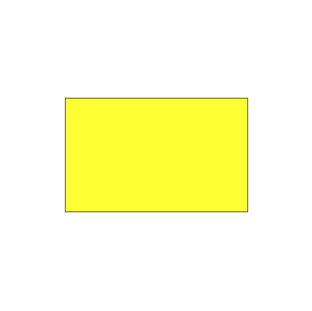
So, the area of the four crescents is the same as the area of the rectangle!
Go back and check your earlier results.
=

Slide 9
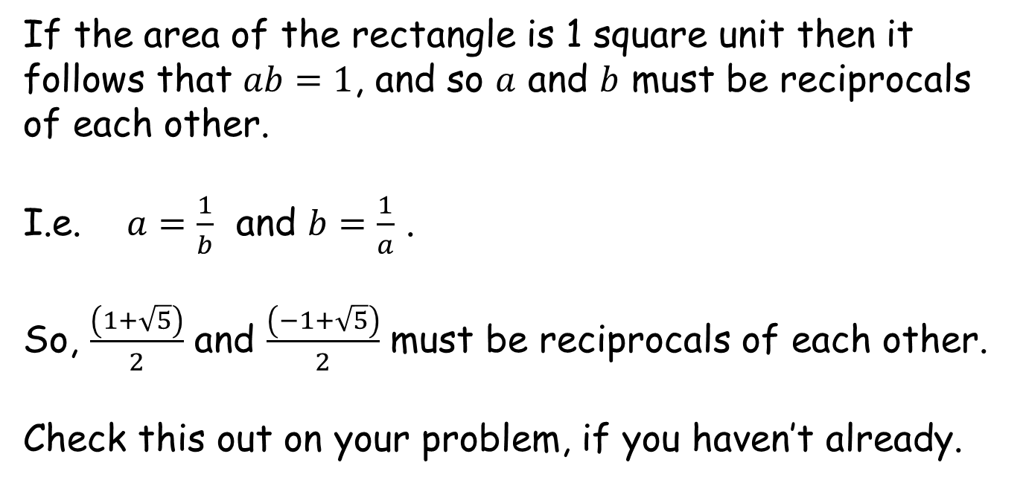
Final thought
If the area of the rectangle is 1 square unit then it follows that $ab=1$, and so $a$ and $b$ must be reciprocals of each other.
I.e. $a=\frac{1}{b}$ and $b=\frac{1}{a}$ .
So, $\frac{\left(1+\sqrt{5}\right)}{2}$ and $\frac{\left(−1+\sqrt{5}\right)}{2}$ must be reciprocals of each other.
Check this out on your problem, if you haven’t already.

Slide 11

Note to Teacher
For the surd worksheets:
    All answers are $1$.

Slide 12
RESOURCES

Slide 13
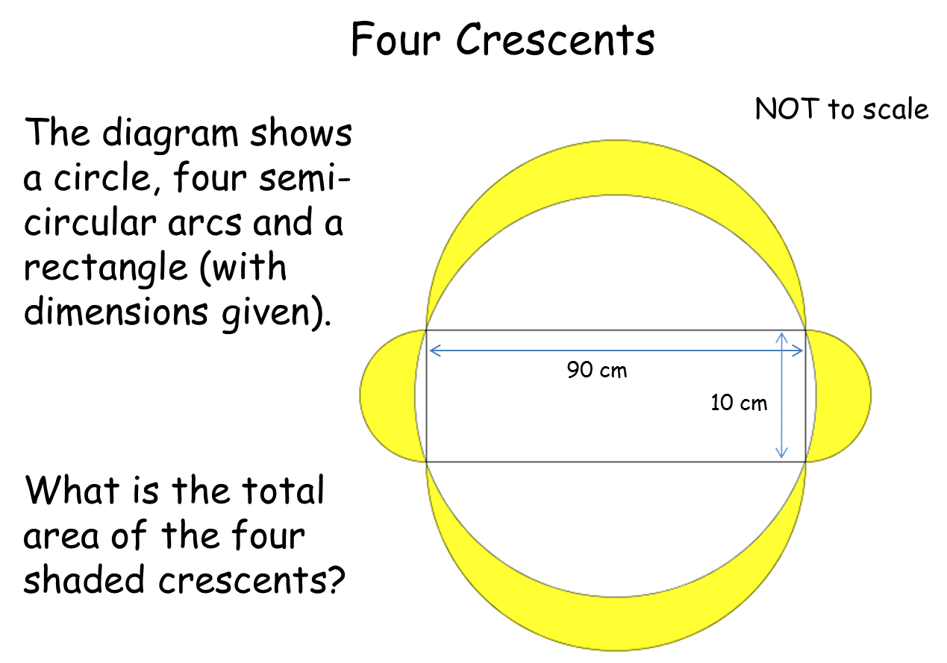


$$\frac{\left(1+\sqrt{10}\right)}{3}$$
$$\frac{\left(−1+\sqrt{10}\right)}{3}$$
SIC_8

Slide 14


$$\frac{\left(1+\sqrt{17}\right)}{4}$$
$$\frac{\left(−1+\sqrt{17}\right)}{4}$$
SIC_8

Slide 15


$$\left(1+\sqrt{2}\right)$$
$$\left(−1+\sqrt{2}\right)$$
SIC_8

Slide 16


$$\frac{\left(1+\sqrt{5}\right)}{2}$$
$$\frac{\left(−1+\sqrt{5}\right)}{2}$$
SIC_8

Slide 17


$$\frac{\left(2+\sqrt{53}\right)}{7}$$
$$\frac{\left(−2+\sqrt{53}\right)}{7}$$
SIC_8

Slide 18


$$\frac{\left(2+\sqrt{29}\right)}{5}$$
$$\frac{\left(−2+\sqrt{29}\right)}{5}$$
SIC_8

Slide 19
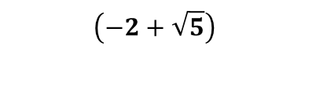

$$\left(2+\sqrt{5}\right)$$
$$\left(−2+\sqrt{5}\right)$$
SIC_8

Slide 20


$$\frac{\left(2+\sqrt{13}\right)}{3}$$
$$\frac{\left(−2+\sqrt{13}\right)}{3}$$
SIC_8

Slide 21


$$\frac{\left(3+\sqrt{58}\right)}{7}$$
$$\frac{\left(−3+\sqrt{58}\right)}{7}$$
SIC_8

Slide 22


$$\frac{\left(3+\sqrt{34}\right)}{5}$$
$$\frac{\left(−3+\sqrt{34}\right)}{5}$$
SIC_8

Slide 23


$$\left(3+\sqrt{10}\right)$$
$$\left(−3+\sqrt{10}\right)$$
SIC_8

Slide 24


$$\frac{\left(3+\sqrt{13}\right)}{2}$$
$$\frac{\left(−3+\sqrt{13}\right)}{2}$$
SIC_8

Slide 25


$$\frac{\left(7+\sqrt{53}\right)}{2}$$
$$\frac{\left(−7+\sqrt{53}\right)}{2}$$
SIC_8

Slide 26


$$\frac{\left(5+\sqrt{29}\right)}{2}$$
$$\frac{\left(−5+\sqrt{29}\right)}{2}$$
SIC_8

Slide 27


$$\left(4+\sqrt{17}\right)$$
$$\left(−4+\sqrt{17}\right)$$
SIC_8

Slide 28


$$\frac{\left(4+\sqrt{41}\right)}{5}$$
$$\frac{\left(−4+\sqrt{41}\right)}{5}$$
SIC_8

Slide 29

Resources 900
    All answers are $900{cm}^{2}$ .

Slide 30
Four Crescents
NOT to scale
The diagram shows a circle, four semi-circular arcs and a rectangle (with dimensions given).
What is the total area of the four shaded crescents?
450 cm
2 cm
SIC_8
Notes:
Area is 900 cm² ( = length x breadth )

Slide 31
Four Crescents
NOT to scale
The diagram shows a circle, four semi-circular arcs and a rectangle (with dimensions given).
What is the total area of the four shaded crescents?
300 cm
3 cm
SIC_8

Slide 32
Four Crescents
NOT to scale
The diagram shows a circle, four semi-circular arcs and a rectangle (with dimensions given).
What is the total area of the four shaded crescents?
225 cm
4 cm
SIC_8

Slide 33
Four Crescents
NOT to scale
The diagram shows a circle, four semi-circular arcs and a rectangle (with dimensions given).
What is the total area of the four shaded crescents?
150 cm
6 cm
SIC_8

Slide 34
Four Crescents
NOT to scale
The diagram shows a circle, four semi-circular arcs and a rectangle (with dimensions given).
What is the total area of the four shaded crescents?
100 cm
9 cm
SIC_8

Slide 35
Four Crescents
NOT to scale
The diagram shows a circle, four semi-circular arcs and a rectangle (with dimensions given).
What is the total area of the four shaded crescents?
60 cm
15 cm
SIC_8

Slide 36
Four Crescents
NOT to scale
The diagram shows a circle, four semi-circular arcs and a rectangle (with dimensions given).
What is the total area of the four shaded crescents?
50 cm
18 cm
SIC_8

Slide 37
Four Crescents
NOT to scale
The diagram shows a circle, four semi-circular arcs and a rectangle (with dimensions given).
What is the total area of the four shaded crescents?
36 cm
25 cm
SIC_8

Slide 38
Four Crescents
NOT to scale
The diagram shows a circle, four semi-circular arcs and a rectangle (with dimensions given).
What is the total area of the four shaded crescents?
75 cm
12 cm
SIC_8

Slide 39
Four Crescents
NOT to scale
The diagram shows a circle, four semi-circular arcs and a rectangle (with dimensions given).
What is the total area of the four shaded crescents?
180 cm
5 cm
SIC_8

Slide 40
Four Crescents
NOT to scale
The diagram shows a circle, four semi-circular arcs and a rectangle (with dimensions given).
What is the total area of the four shaded crescents?
45 cm
20 cm
SIC_8

Slide 41
Four Crescents
NOT to scale
The diagram shows a circle, four semi-circular arcs and a rectangle (with dimensions given).
What is the total area of the four shaded crescents?
90 cm
10 cm
SIC_8

